Slide 1

METHARAM Michael
RICCARDI Gianni
TEETSOV Aurianne
Notes:
ASK ONLY ONE QUESTION: How concerned are you with the issues of climate change?

Slide 2


Slide 3
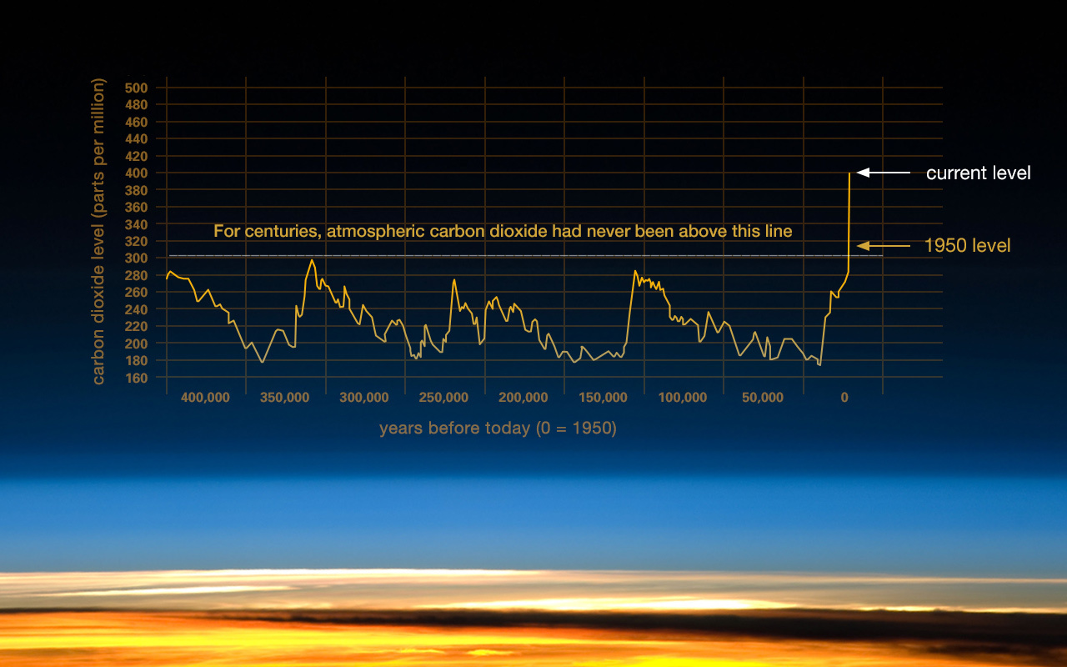

Slide 4
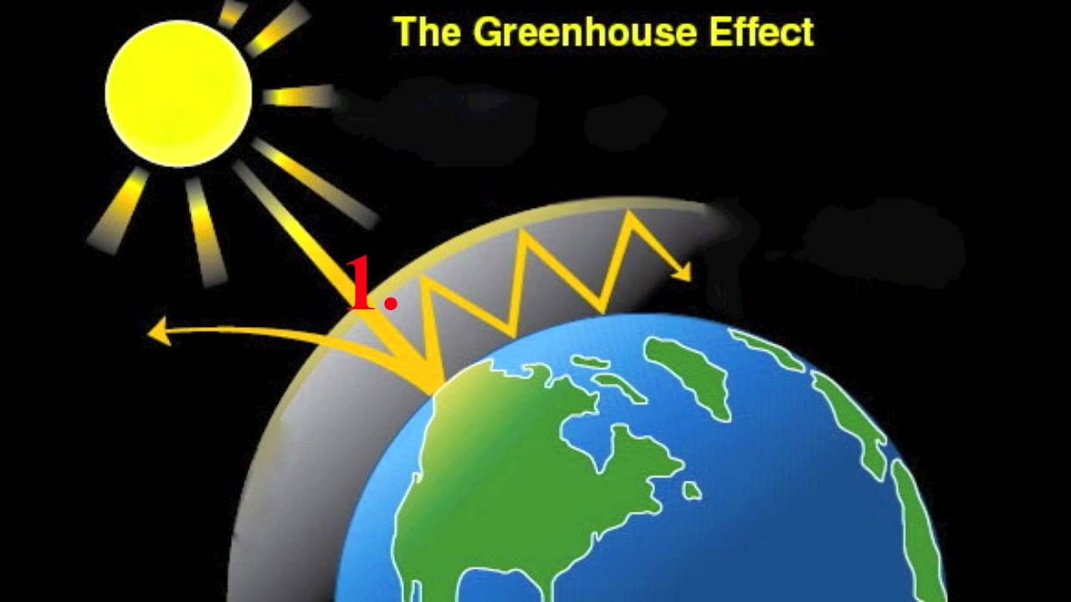
Notes:
Expliquer greenhouse
ask a question:

Slide 5
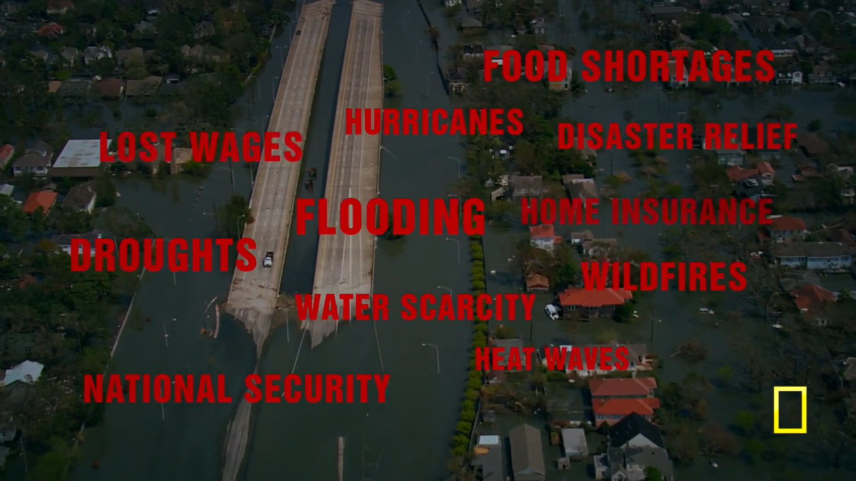
Notes:
not only global warming, global cooling
PLAY VIDEO AfTER THIS SLIDE ⇒ timestamp: 28:00 - 28:20

Slide 6
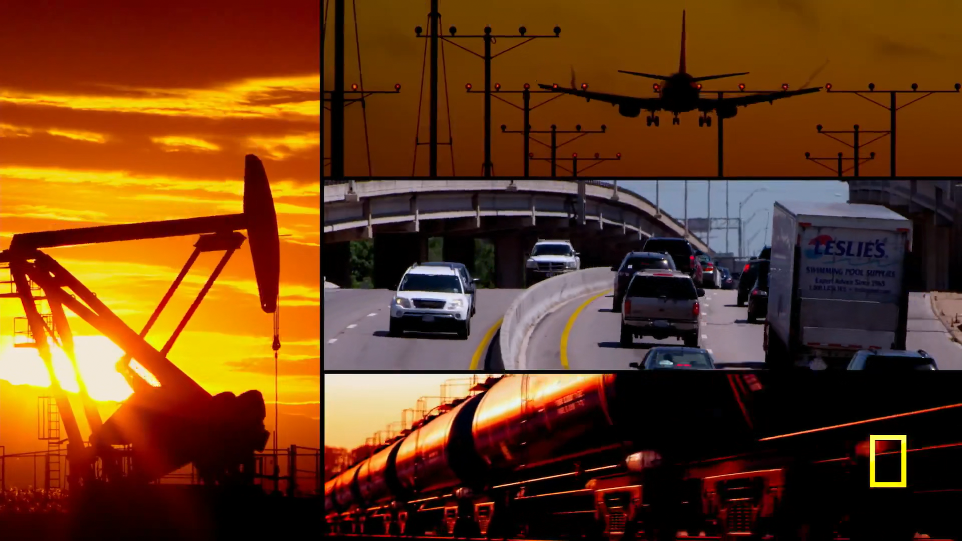

Slide 7
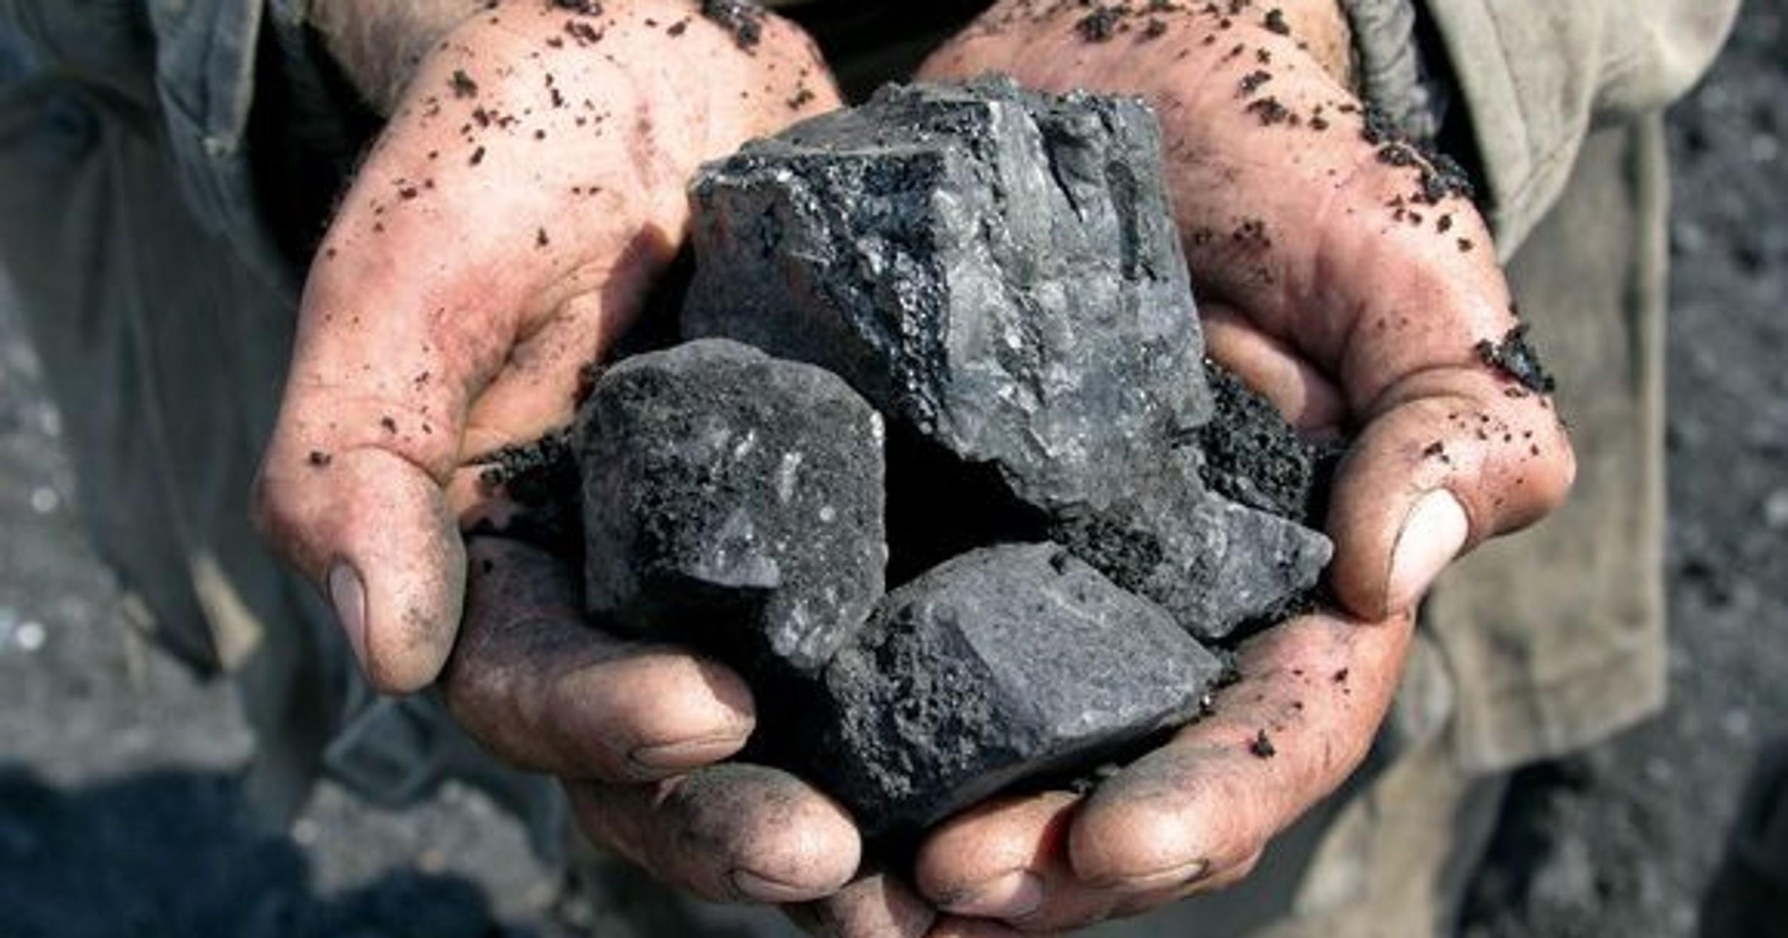

Slide 8
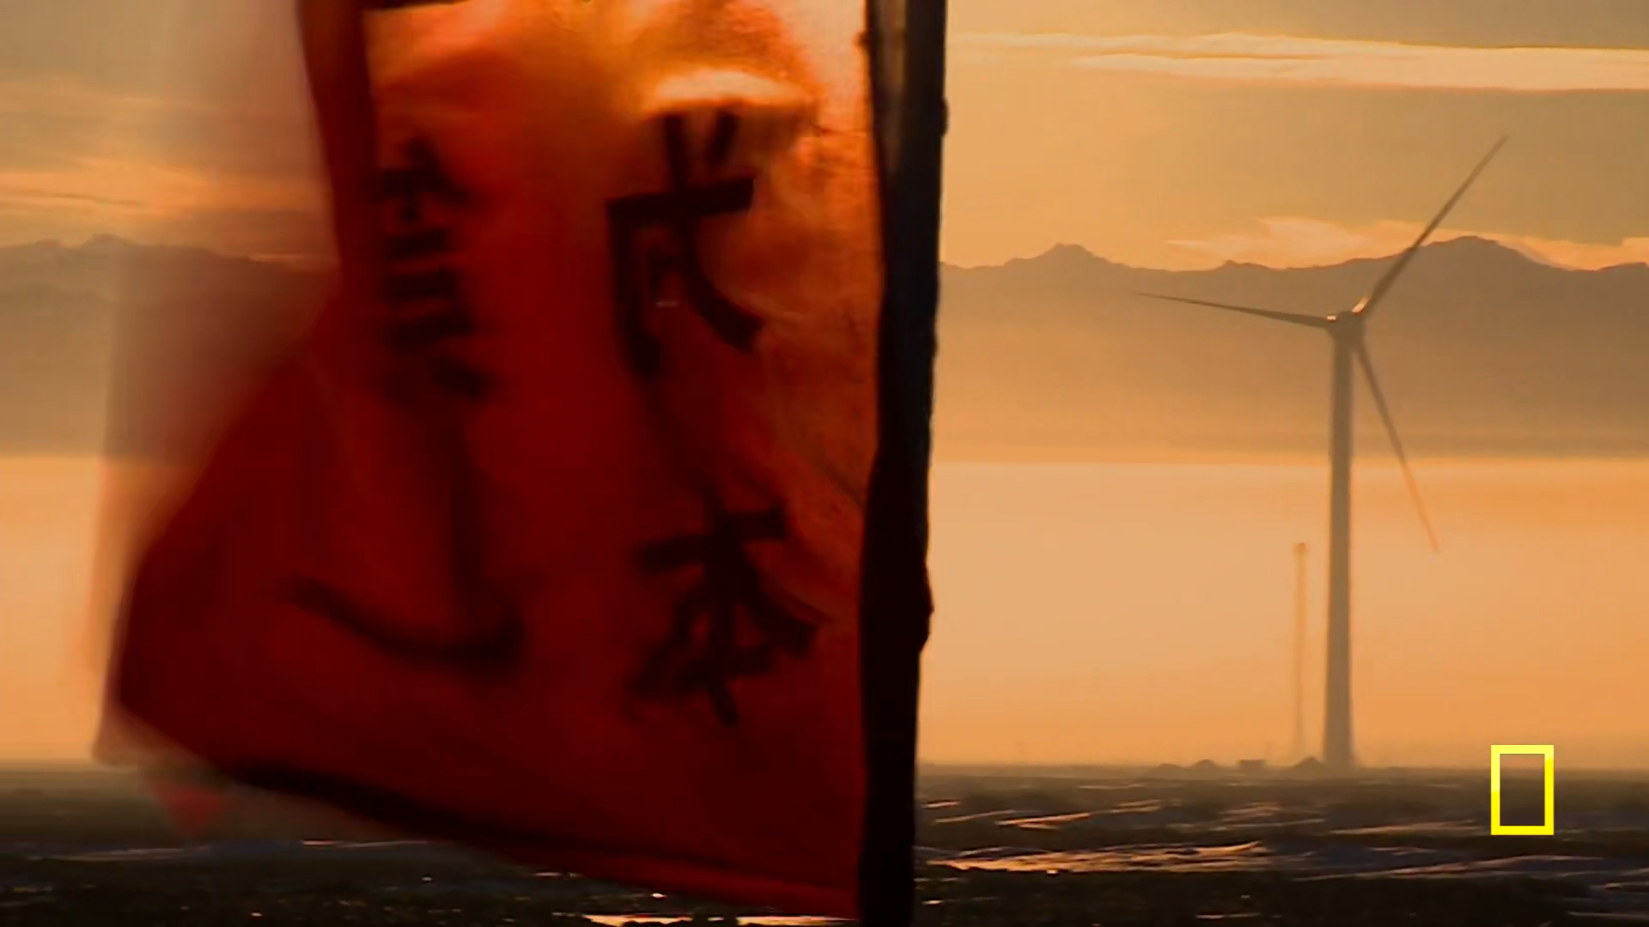
Notes:
China transitioning

Slide 9
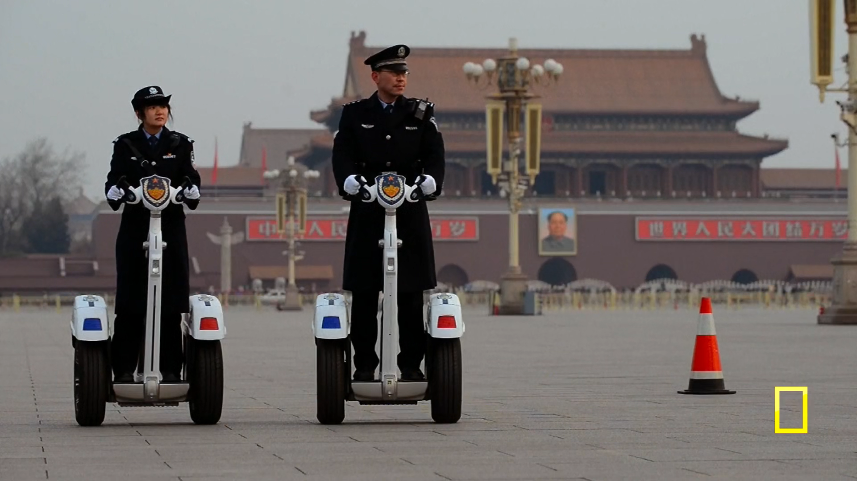

Slide 10
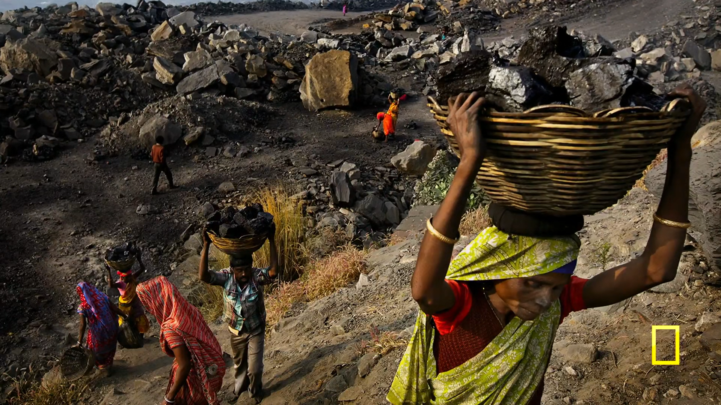
inde et video
Notes:
PLAY VIDEO AFTER:

Slide 11
VIDEO

Slide 12
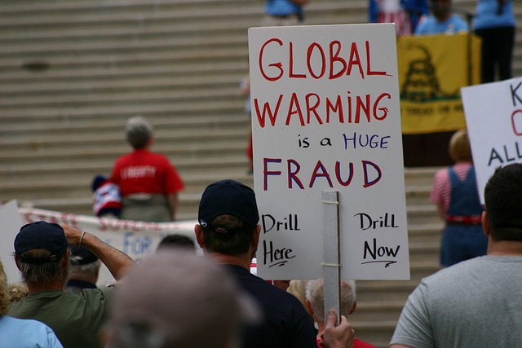
Notes:
Climate Change deniers extract 22:44 - 23:41

Slide 13
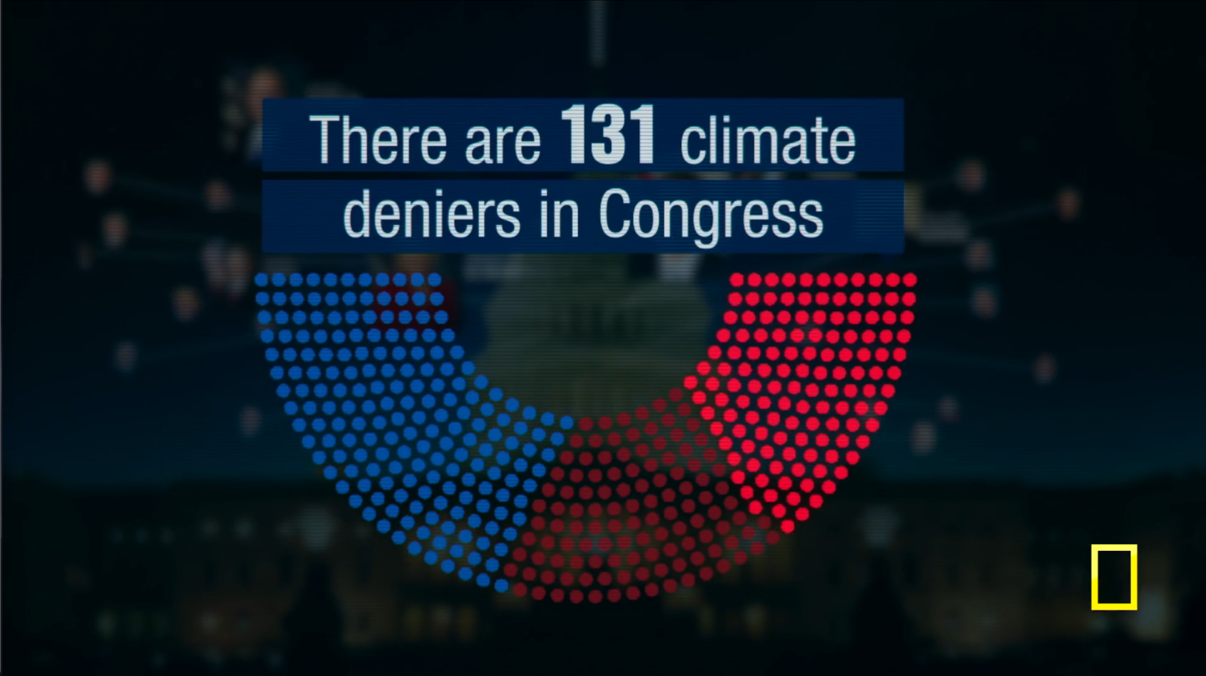

Slide 14
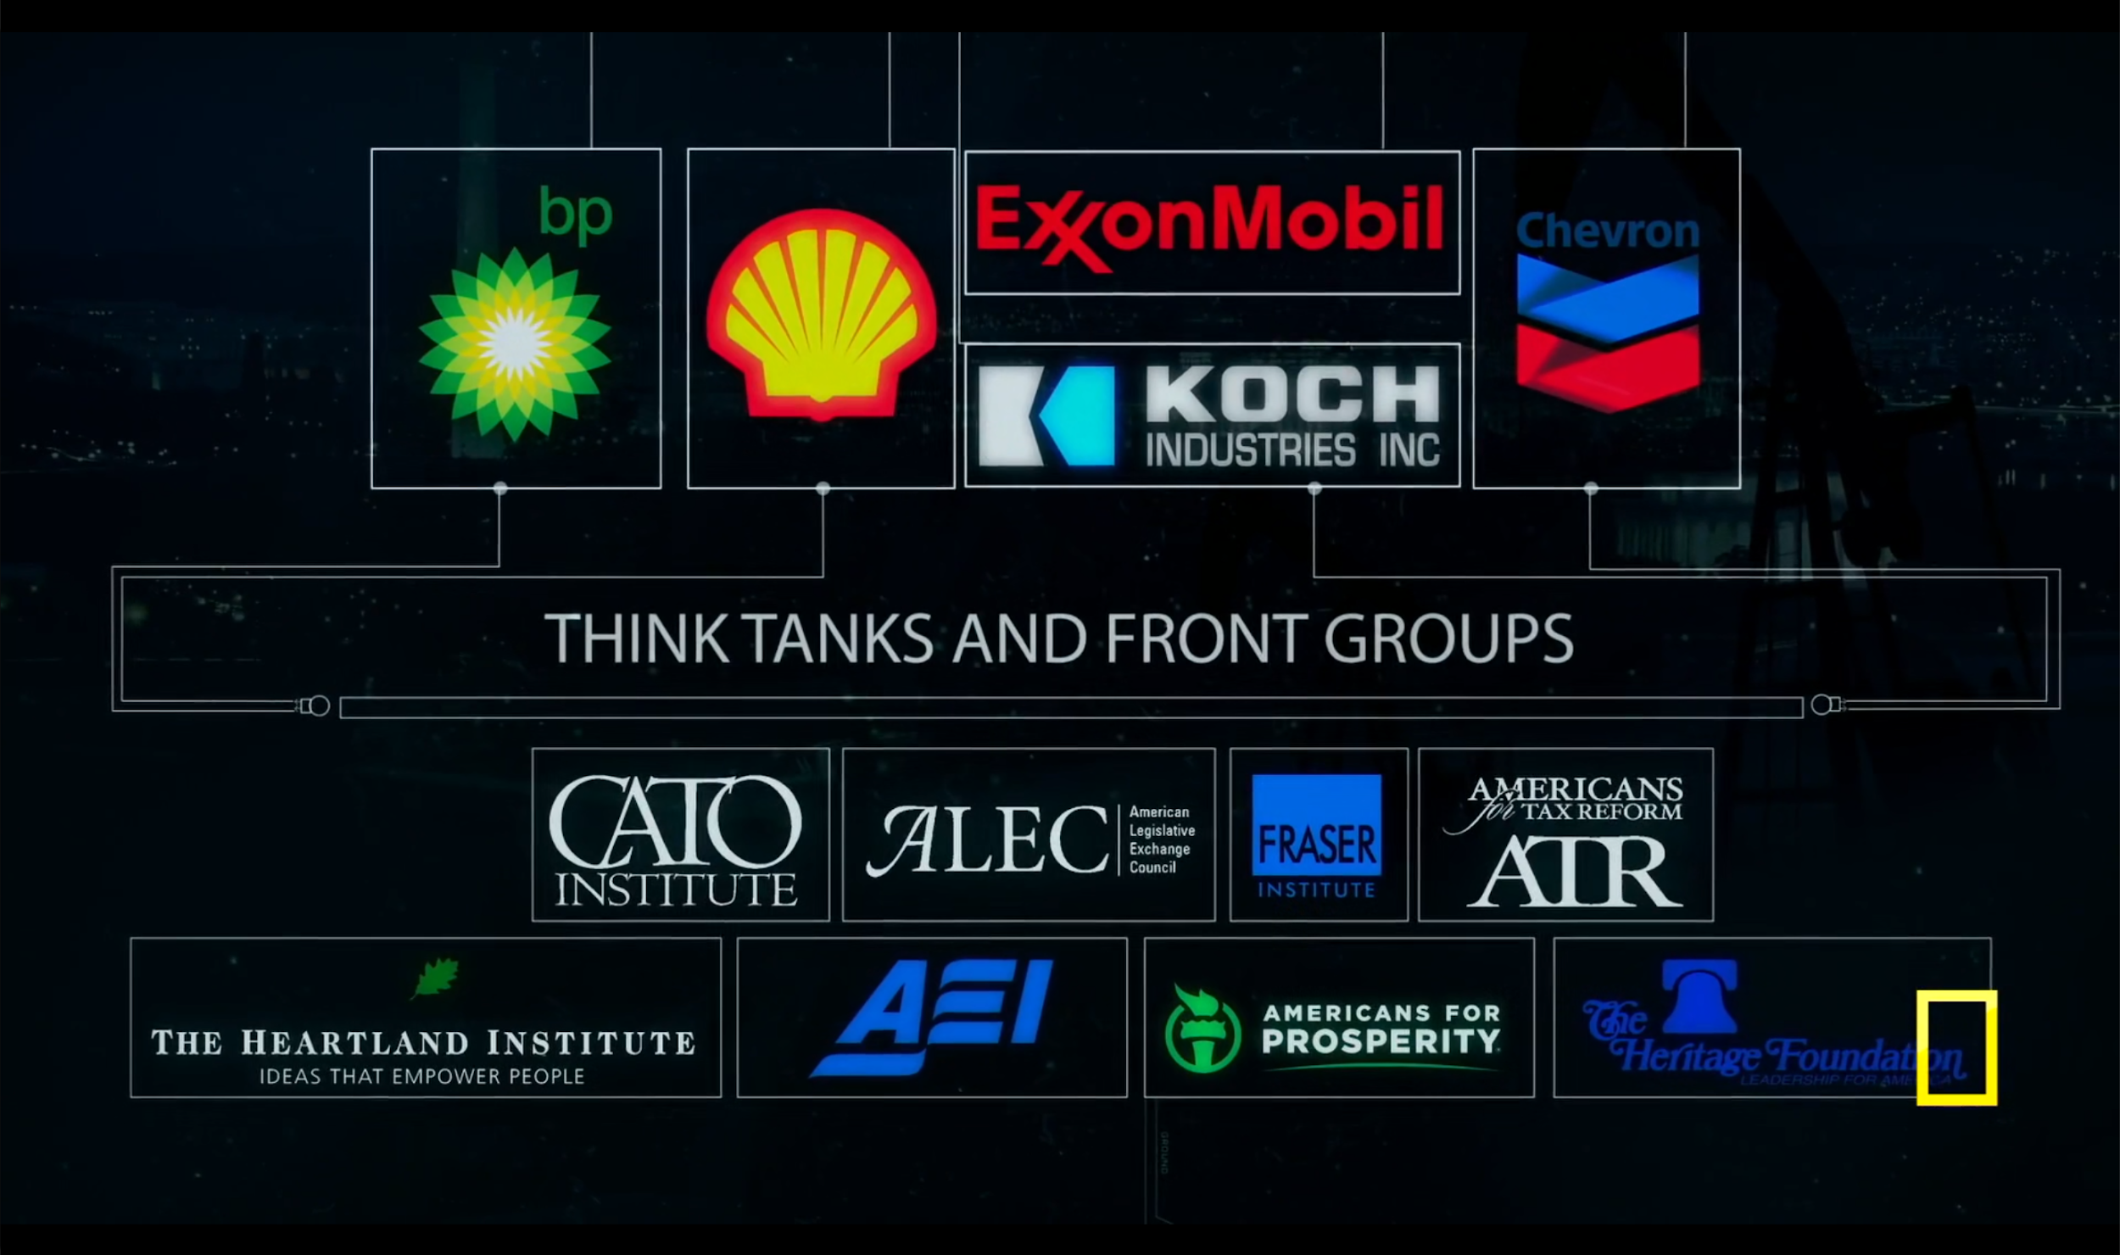

Slide 15
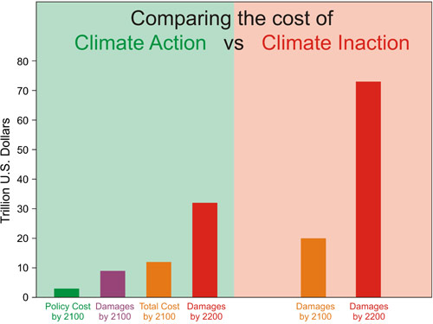

Slide 16
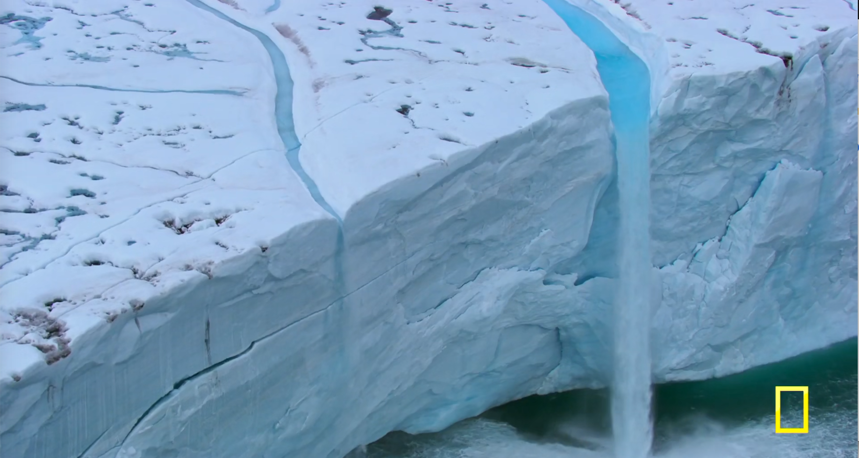
Notes:
18:40 - 19:30 Glacier melt (Greenland)

Slide 17
ANY SOLUTIONS ?

Slide 18
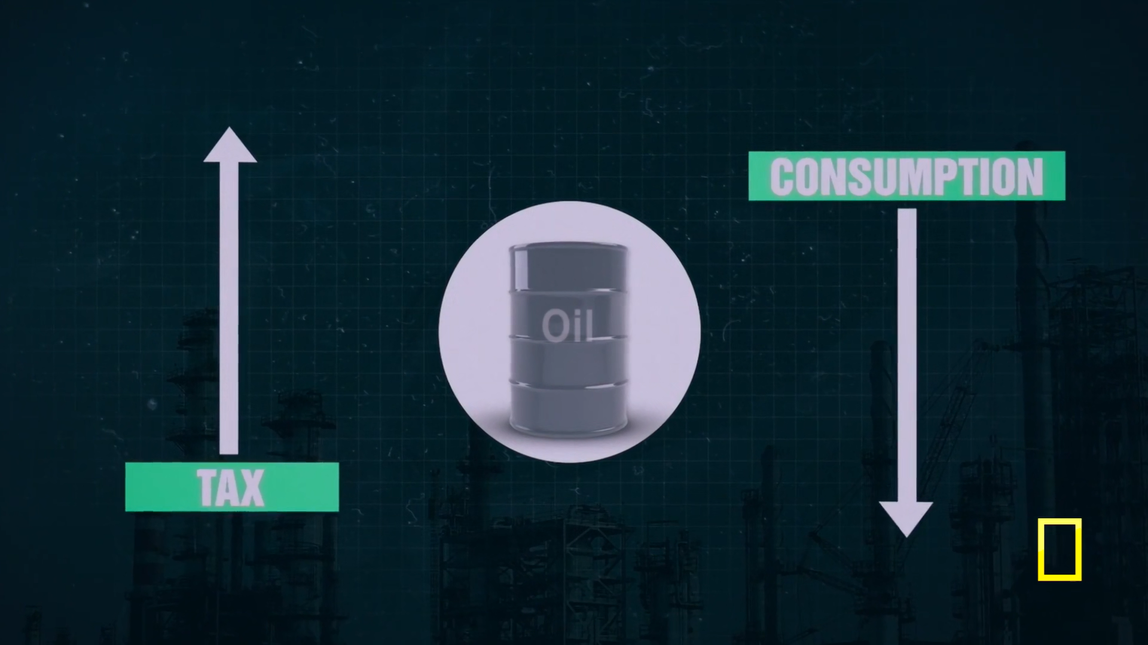

Slide 19
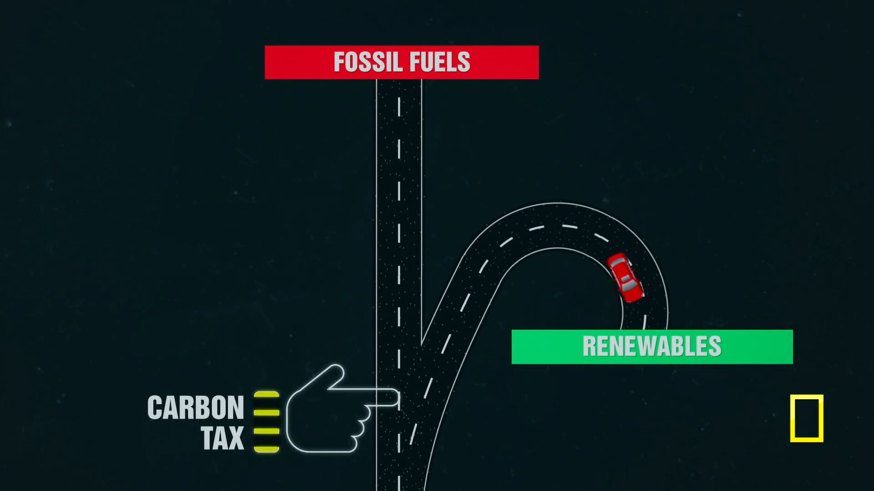

Slide 20
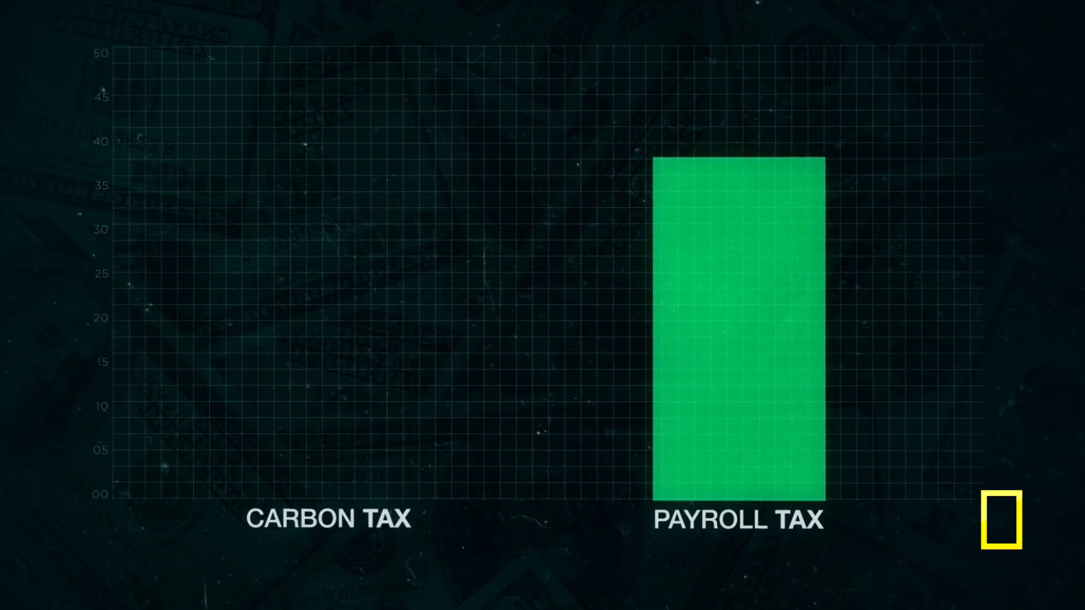

Slide 21
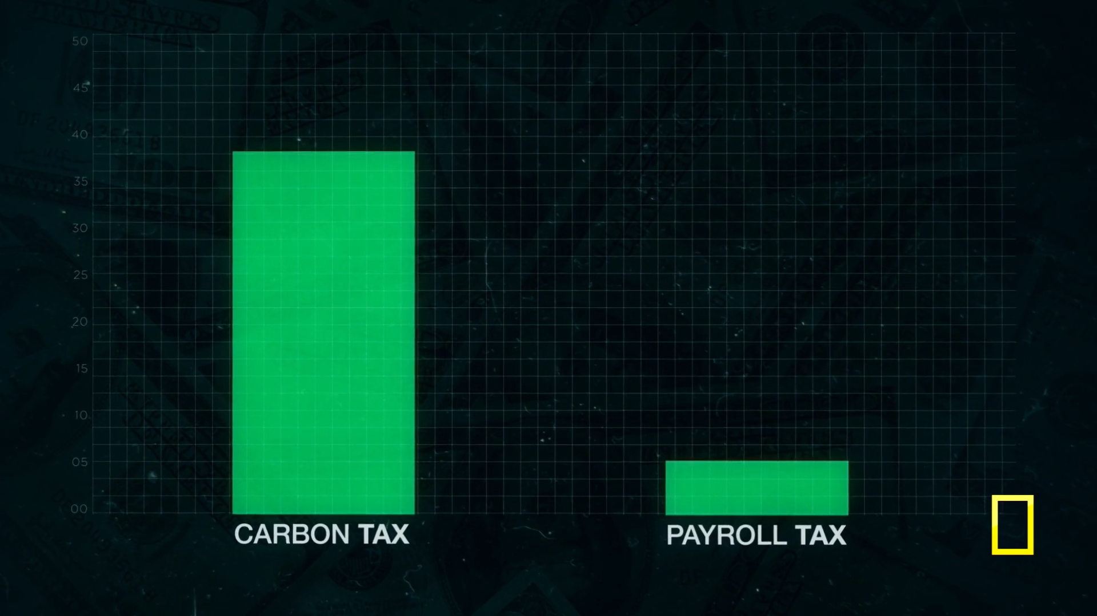

Slide 22
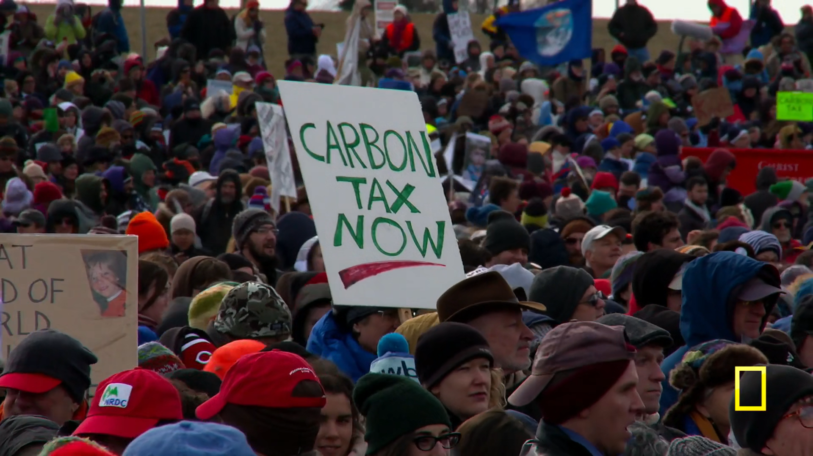

Slide 23
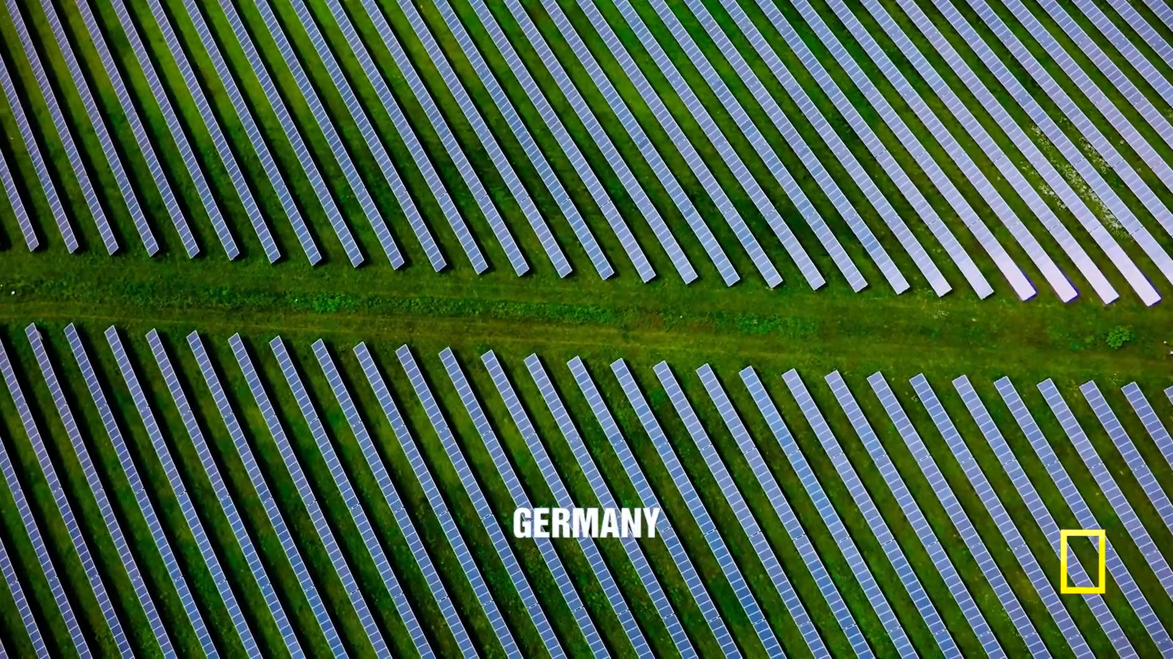

Slide 24
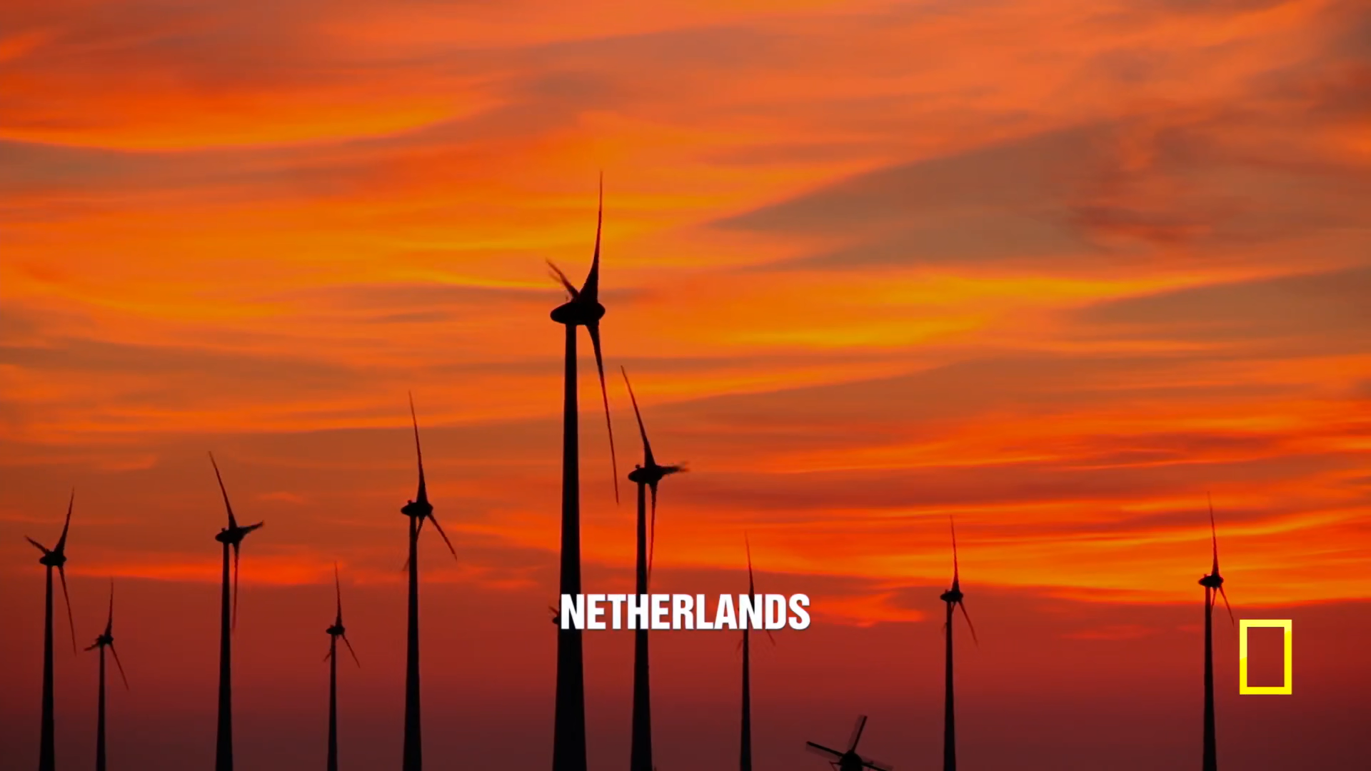

Slide 25
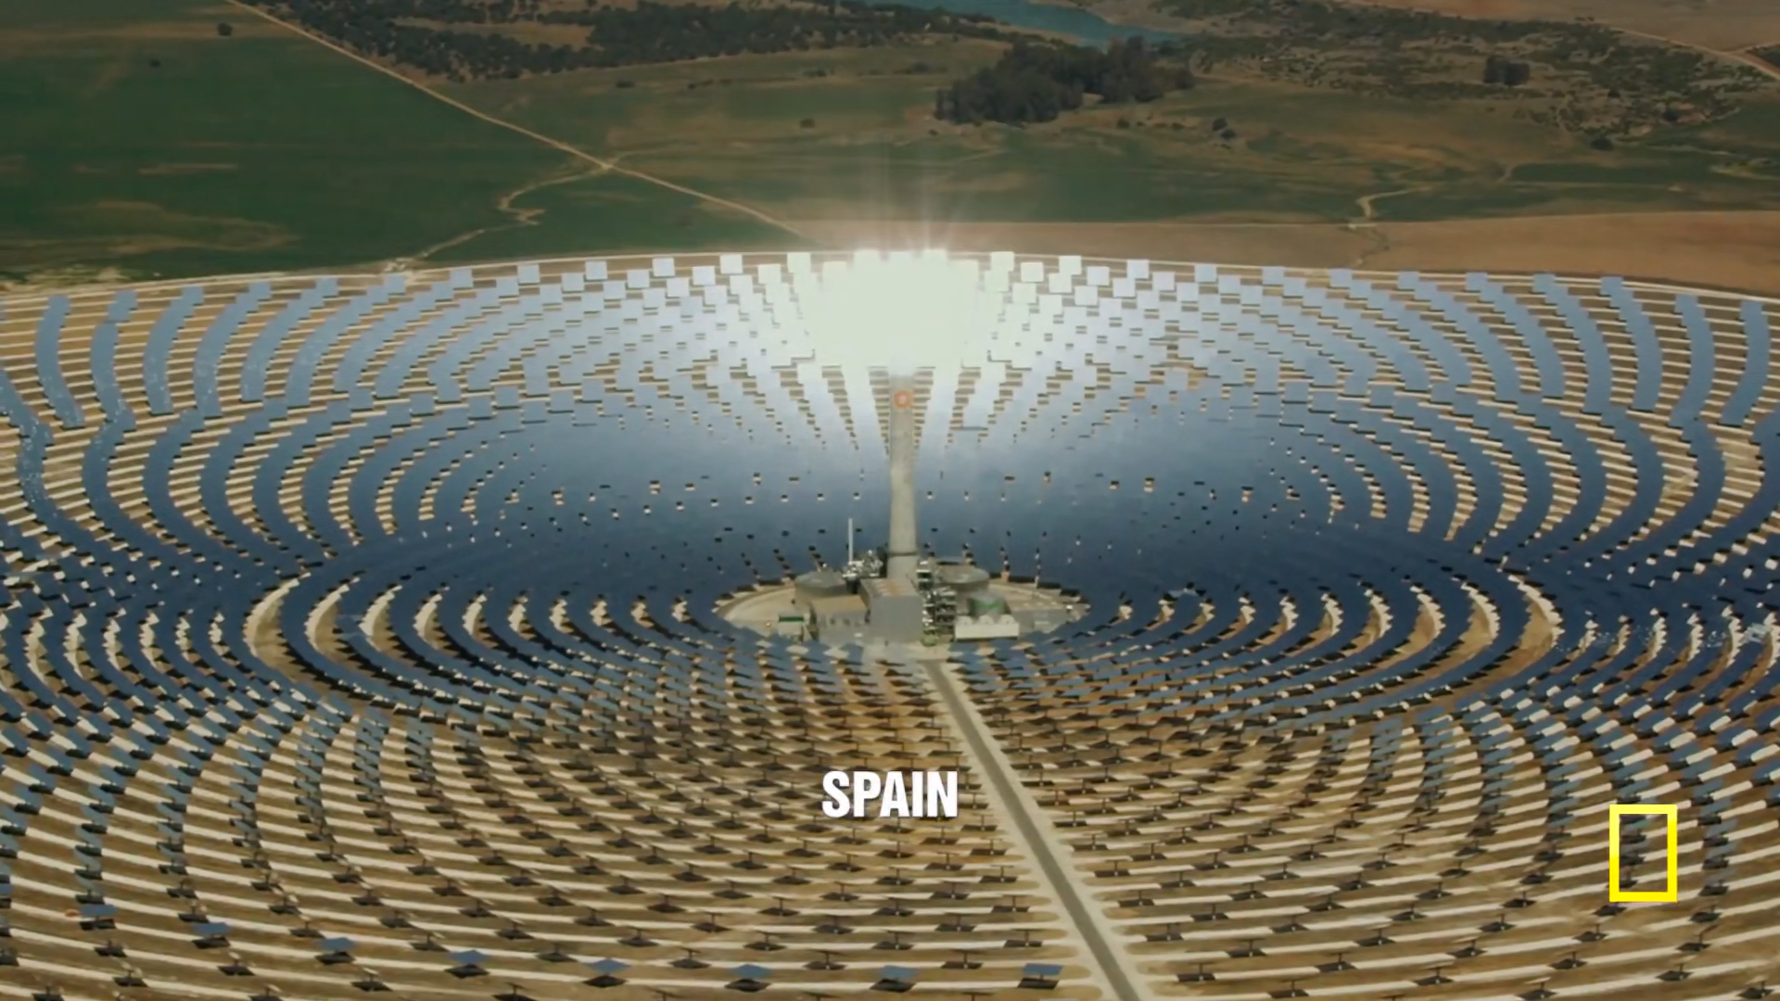

Slide 26
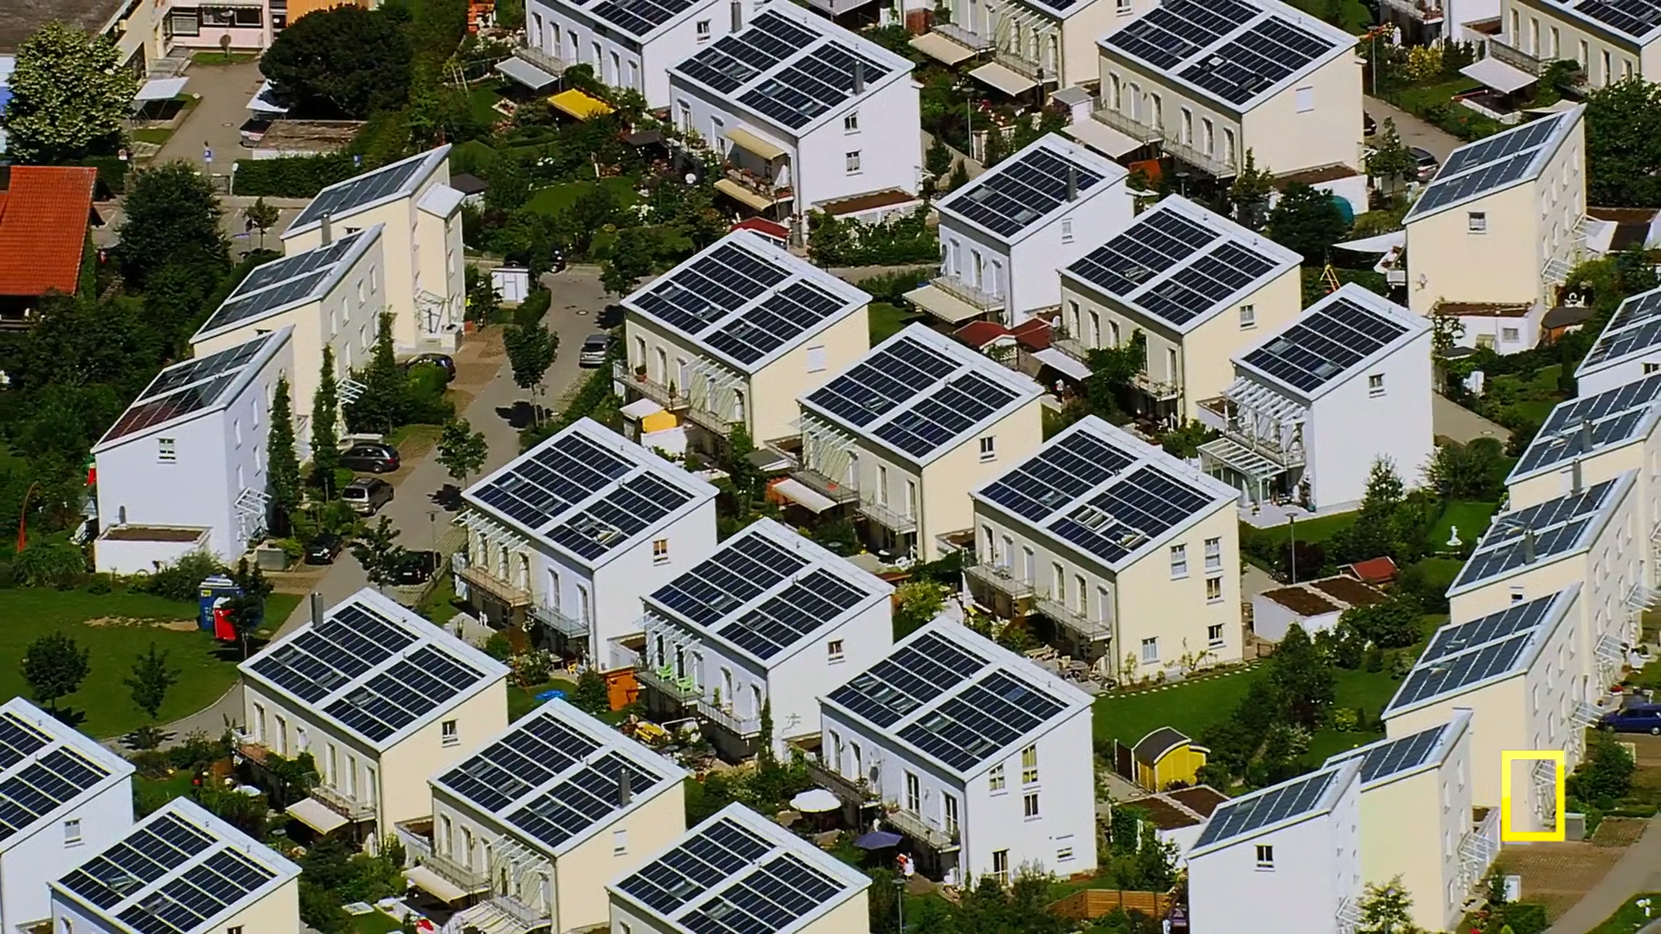

Slide 27
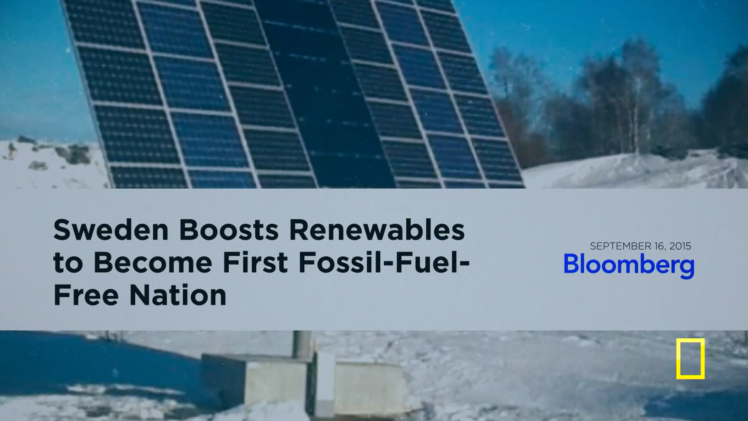

Slide 28
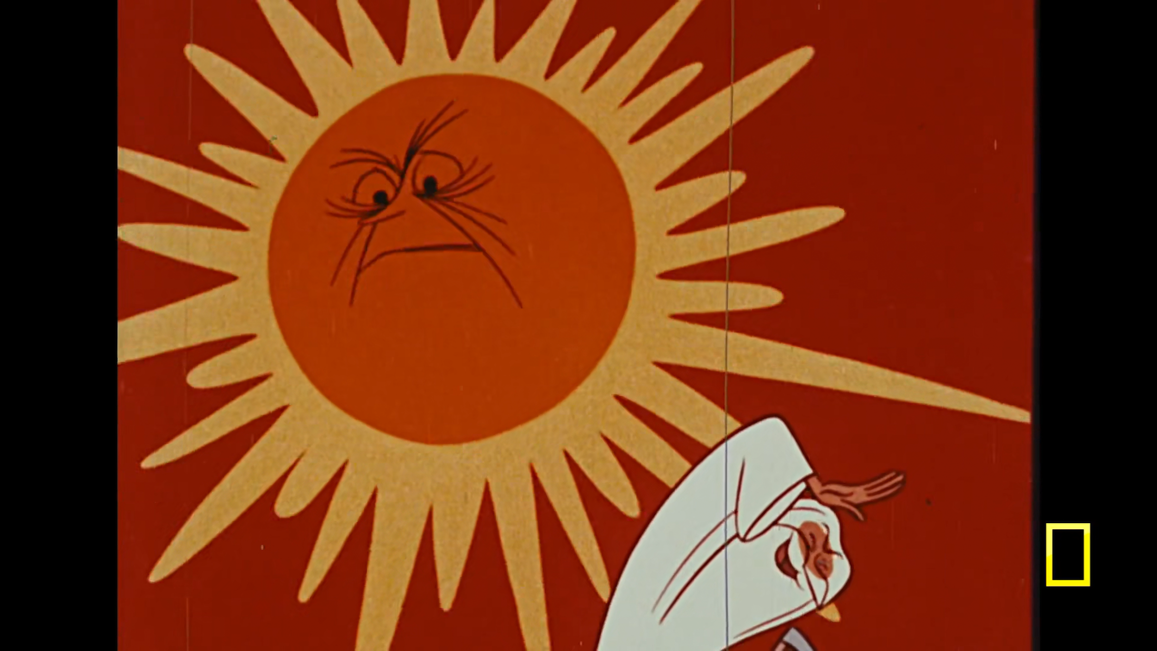
Notes:
documentary describes use of solar energy as a possible alternative to burning fossil fuel; dates back to the 1950s, showing that these (potential) solutions were known but were not taken seriously (considered as

Slide 29
WHAT CAN YOU DO TODAY ?

Slide 30
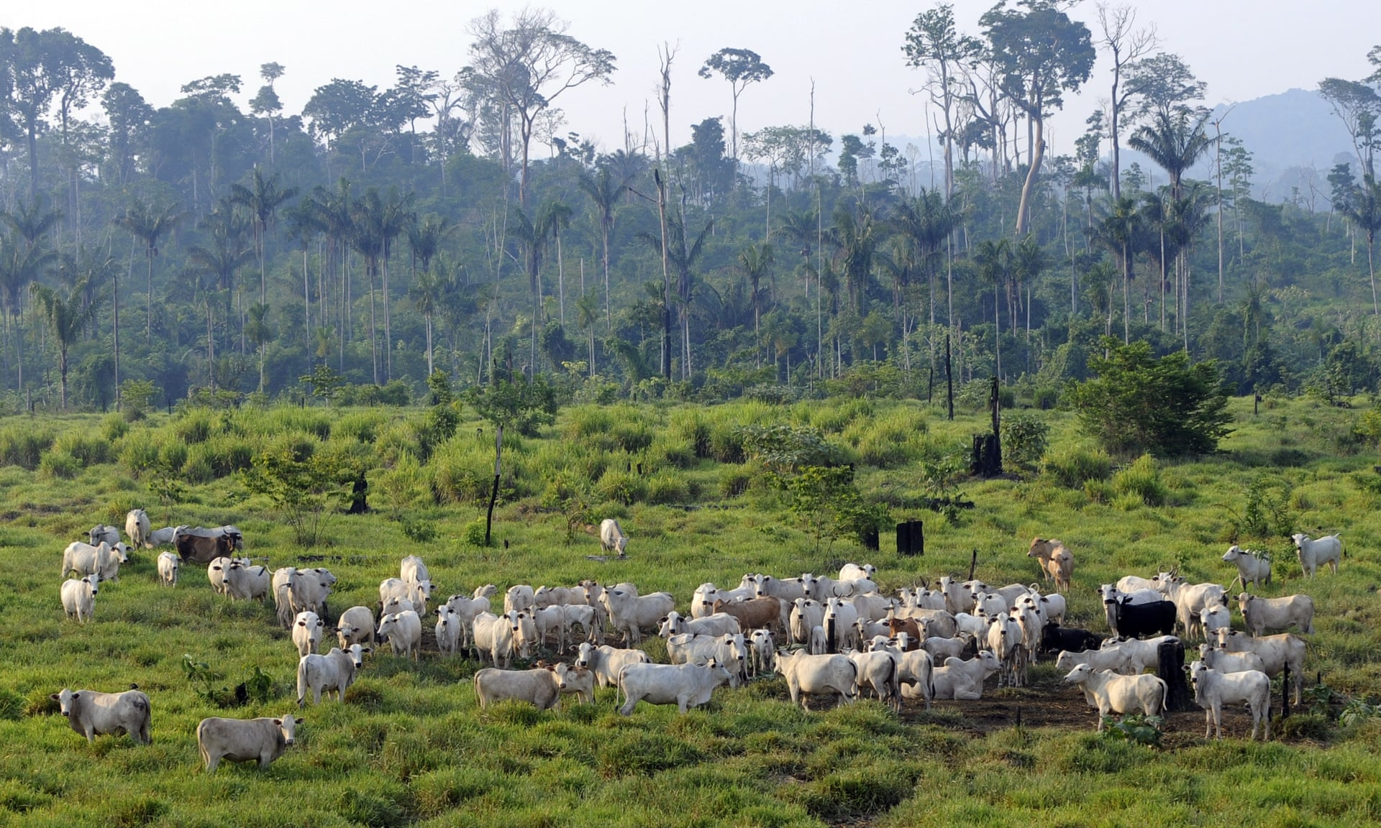

Slide 31
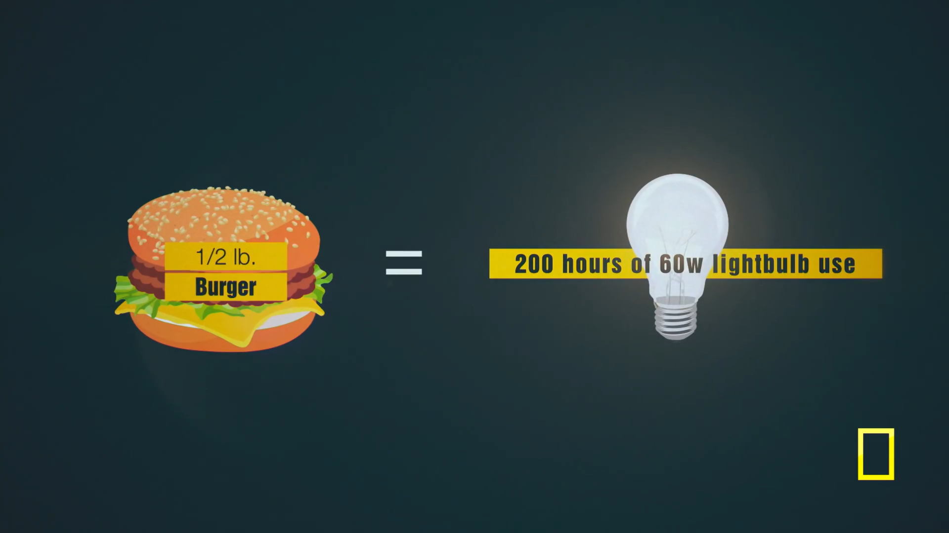

Slide 32
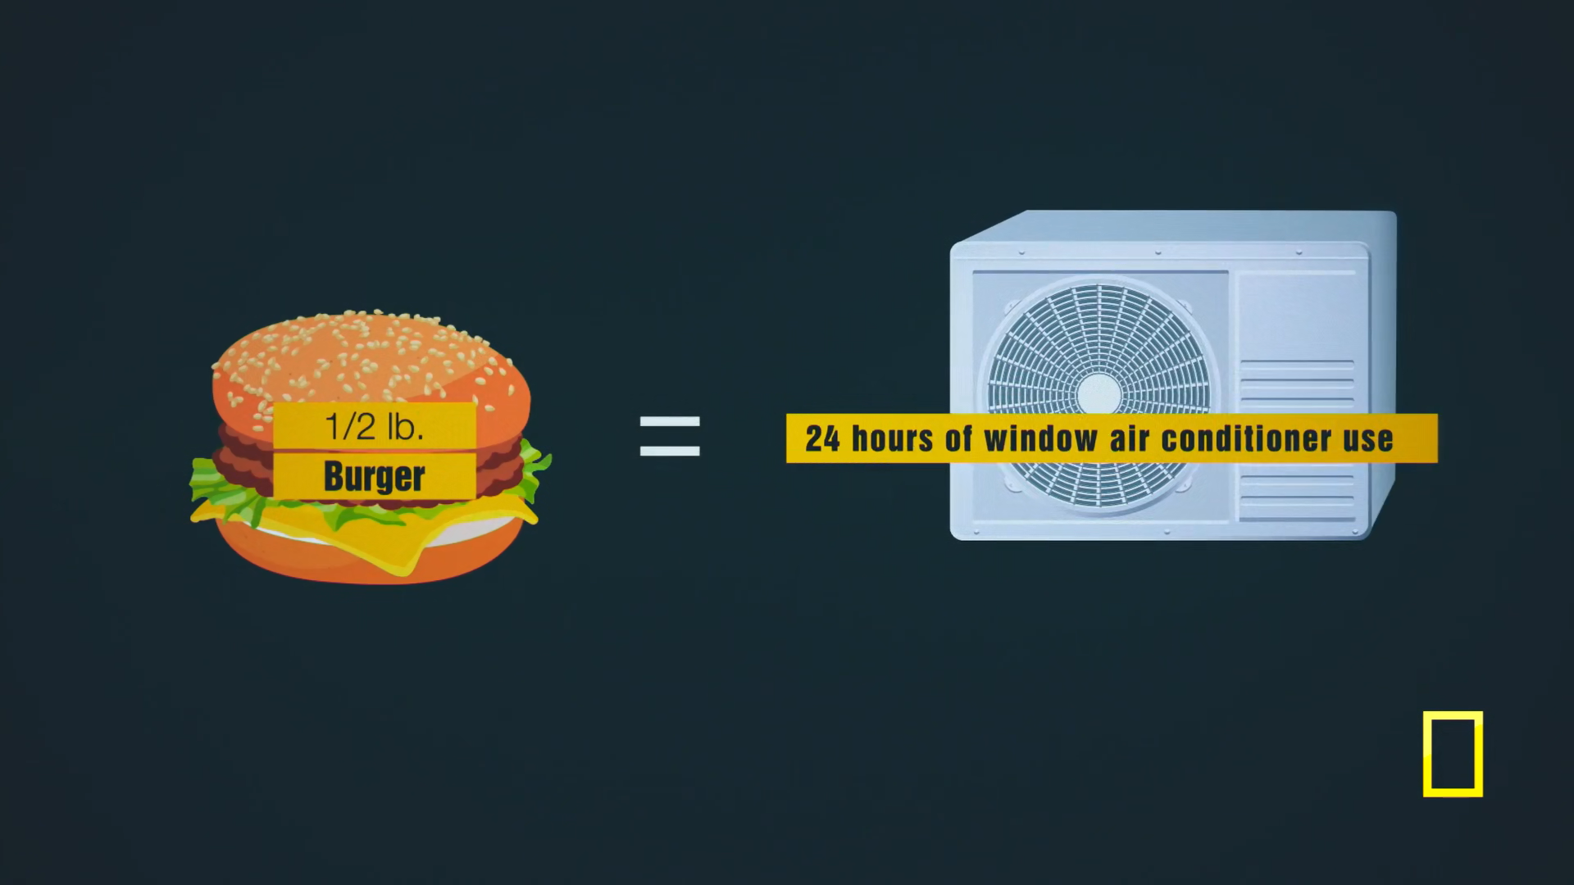

Slide 33
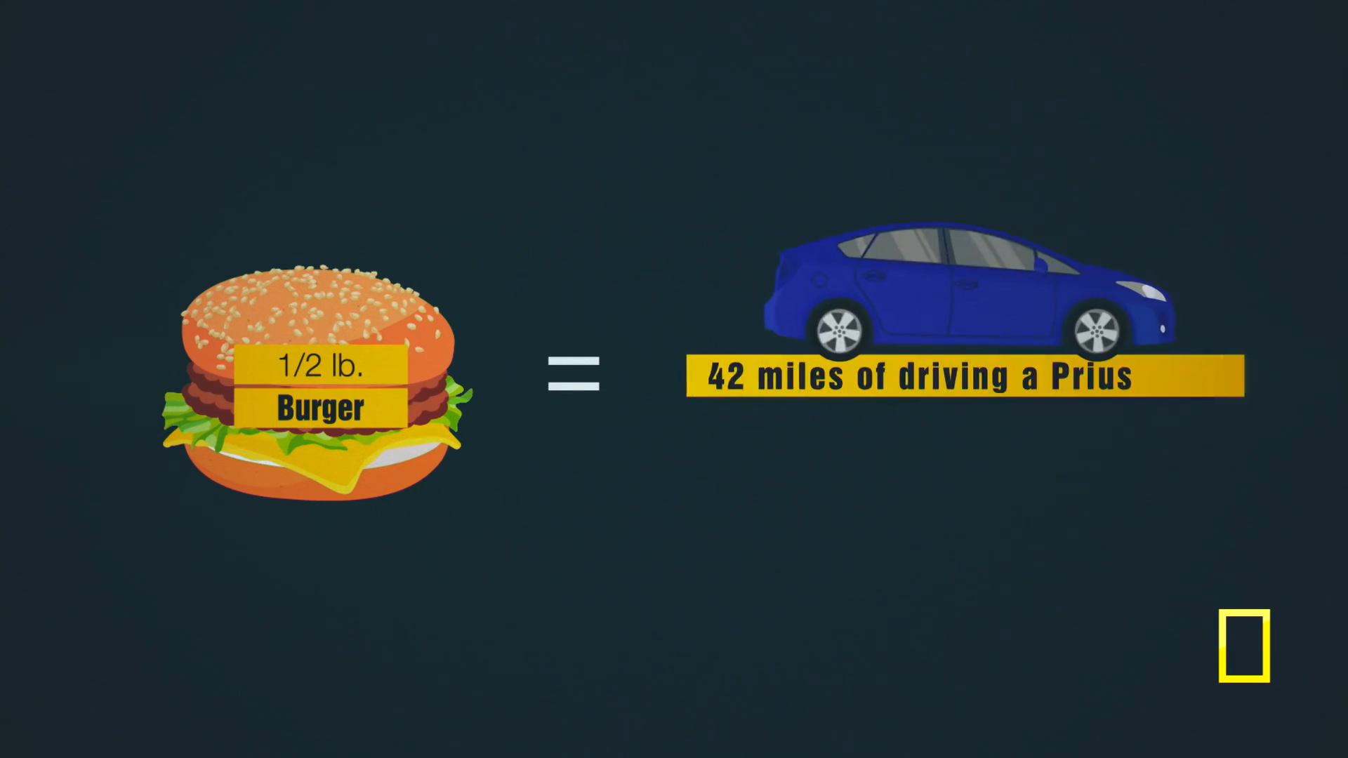

Slide 34
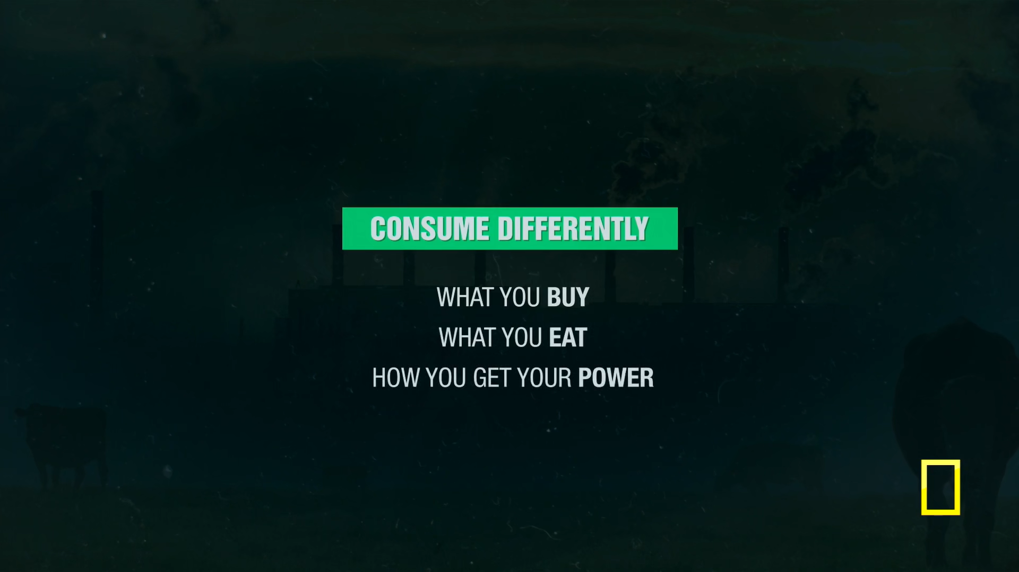

Slide 35
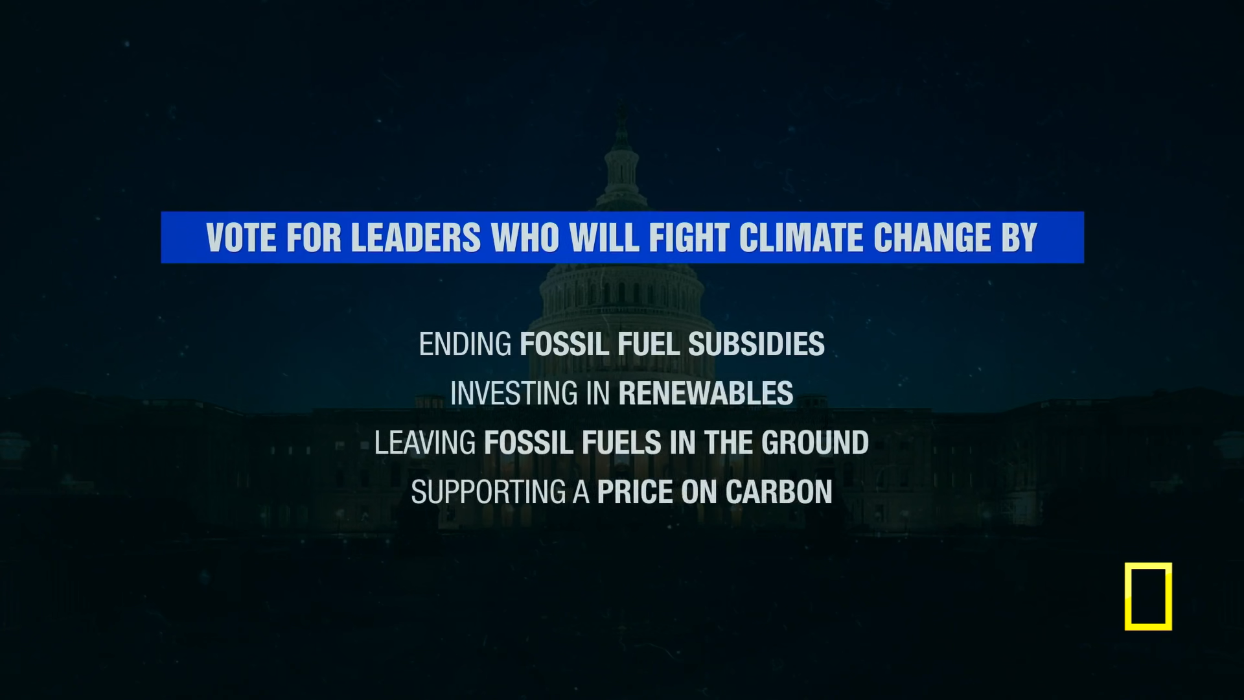

Slide 36
